Slide 1
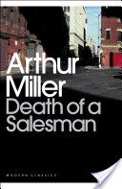
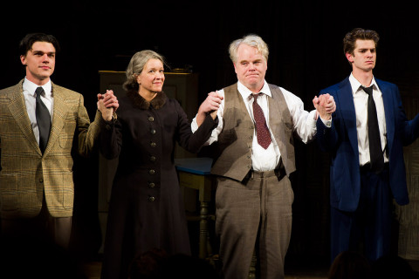
Death of a Salesman
Research task/historical context

Slide 2
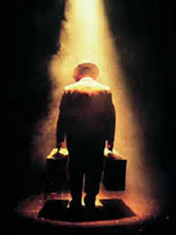
Aim
Understand the historical context of the play ‘Death of a Salesman.’

Slide 3
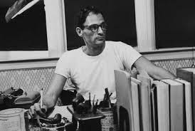
Find out as much as you can about the following:
Arthur Miller (playwright)
‘Death of a Salesman’ and his other works
The Great Depression
Tragic hero
Capitalism
McCarthyism and Communism
The American Dream
You may present your findings in a Word Doc/ PPT

Slide 4
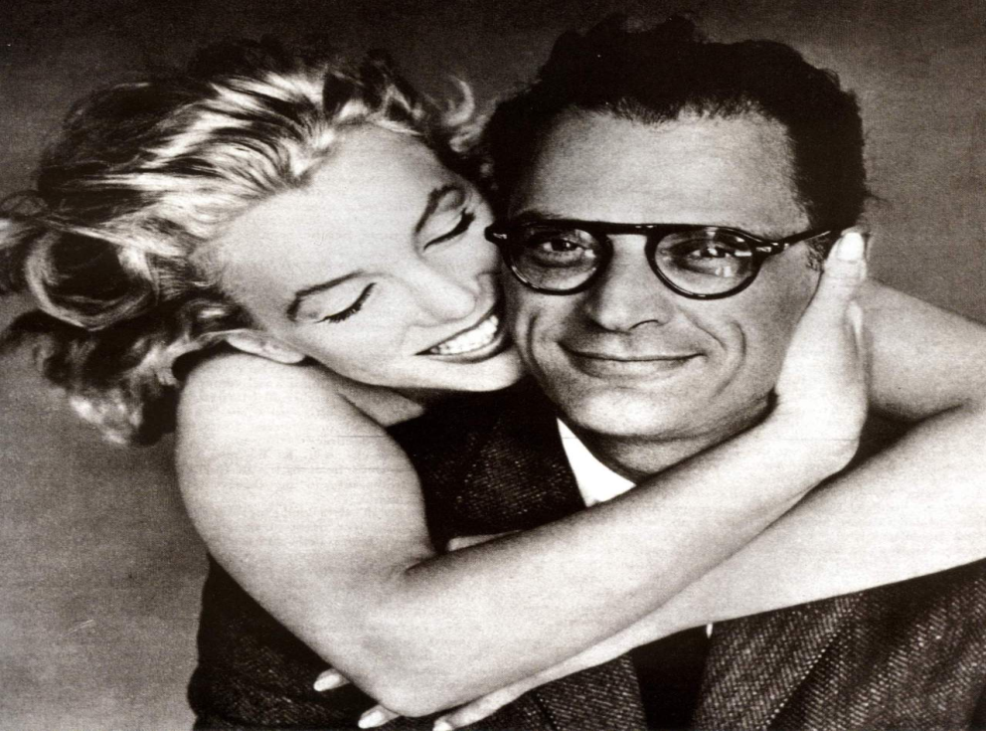
Arthur Miller
Miller was born in Harlem, NY to Jewish parents in 1915, and grew up during the American depression.
His father’s clothing business experienced financial difficulties.
Miller, like the play’s protagonist Willy Loman, worked as a salesman for a brief period.
The economic crash of the Depression put great pressure on relationships in the Miller family.
Miller famously married Marilyn Monroe (they divorced after 5 years)
In 1949 Miller was awarded the Pulitzer Prize for ‘Death of a Salesman’.
Miller died in February 2005.

Slide 5
‘Death of a Salesman’ and his other works
When it was first performed on Broadway, ‘Death of a Salesman’ ran for 742 performances, and was a striking success.
It cemented Miller’s reputation as a leading American dramatist and some critics labelled ‘Death of a Salesman’ the American ‘King Lear’. The play focuses on the tragic demise of Willy Loman, an aging salesman, who has been unable to attain the elusive ‘American Dream.’
Miller was a prolific writer, best known for his plays, which include: ‘All my Sons’, ‘The Crucible’ and ‘A View from the Bridge.’

Slide 6
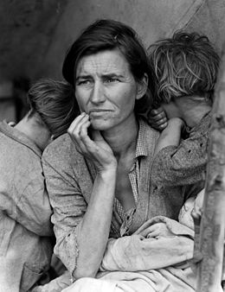
The Great Depression
The Great Depression was a severe worldwide economic depression in the decade preceding World War II. The timing of the Great Depression varied across nations, but in most countries it started in 1930 and lasted until the late 1930s or middle 1940s. It was the longest, deepest, and most widespread depression of the 20th century.
The depression originated in the U.S., after the fall in stock prices that began around September 4, 1929, and became worldwide news with the stock market crash of October 29, 1929 (known as Black Tuesday).

Slide 7
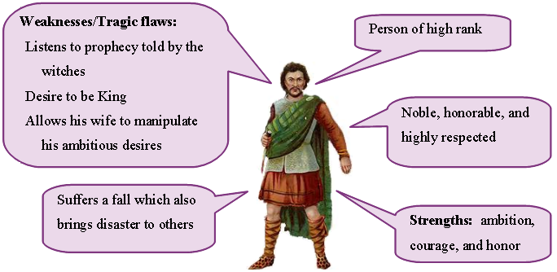
Tragic Hero
Traditionally, a tragic hero in literature was someone of high birth who made a fatal mistake and then severely punished.
Willy Loman (low man) is clearly not of high social status. However, Miller implies that Willy’s tragedy is that he worked for nothing: ultimately his life lacked meaning.

Slide 8
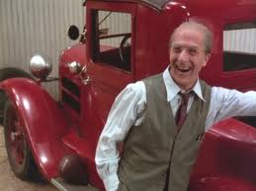
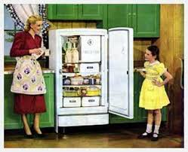
Capitalism
Capitalism is an economic system in which investment in and ownership of the means of production, distribution, and exchange of wealth is made and maintained chiefly by private individuals or corporations, especially as contrasted to cooperatively or state-owned means of wealth.
Some have said that ‘Death of a Salesman’ is an attack on capitalism. Miller clearly criticises the capitalist system which encourages people to want more and more goods, such as refrigerators, as if this is the ultimate point of existence.

Slide 9
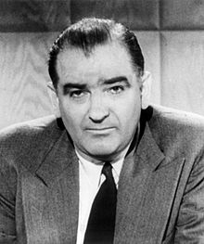
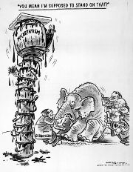
McCarthyism and Communism
In 1953 Miller wrote ‘The Crucible’, a story of the persecution of witches in the early America of 1692. The plot is a thinly disguised treatment of contemporary events.
Senator Joseph McCarthy was the leading force in a campaign during the 1950s to bring to light any Communists who existed in America. Cold war tensions were running high in America at this point.
In 1957 Miller was brought before the Congressional Committee which investigated ‘un-American activities.’ He was convicted of contempt of congress and refused to name anyone who had expressed left-wing sympathies. This was reversed the following year by the Supreme Court.

Slide 10
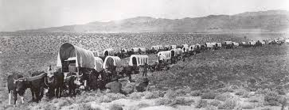
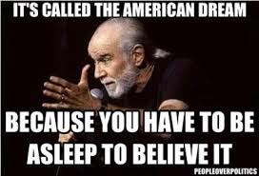
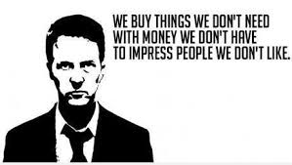
The American Dream
The American Dream offers the chance of riches to those who start with nothing; it harks back to the early history of America, in which pioneers conquered the wilderness of the frontier. It is a philosophy based on individualism and materialism. America was renowned as the land of opportunity. The ‘get rich quick’ American Dream is still in evidence today.

